Slide 2
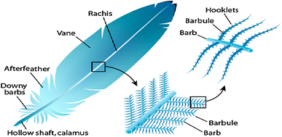
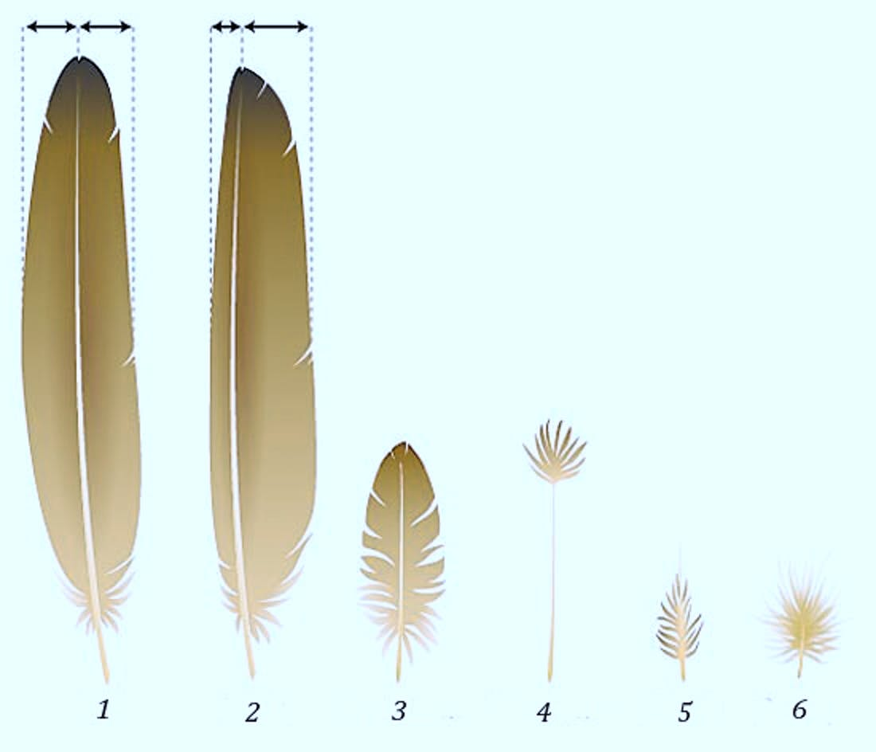
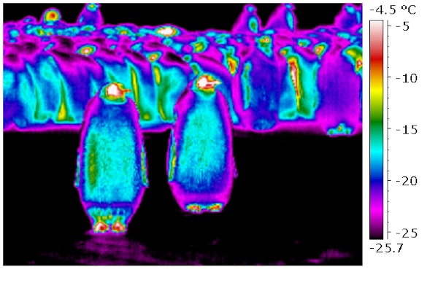
Feathers vs Fur

Slide 3
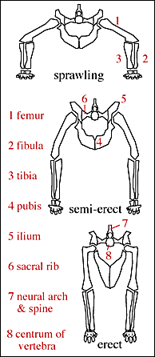
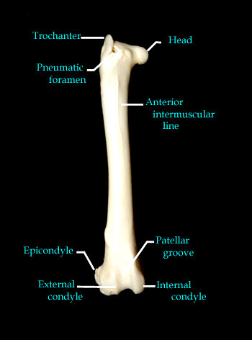
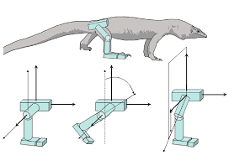
Avian osteology
Notes:
Structure of radius and ligaments causes wrist to flex and extend at the same time as the elbow automatically (that is, without additional energy spent on muscle motion)

Slide 4
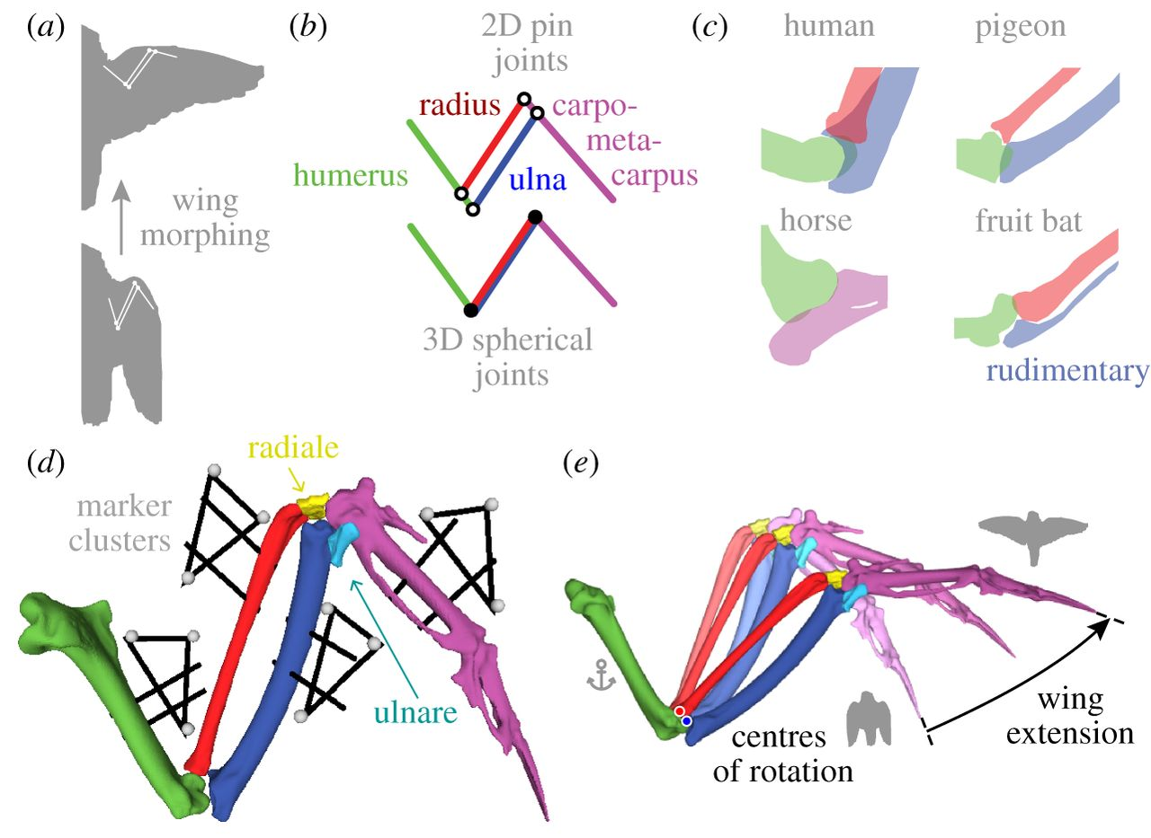
Notes:
Structure of radius and ligaments causes wrist to flex and extend at the same time as the elbow automatically (that is, without additional energy spent on muscle motion)

Slide 5
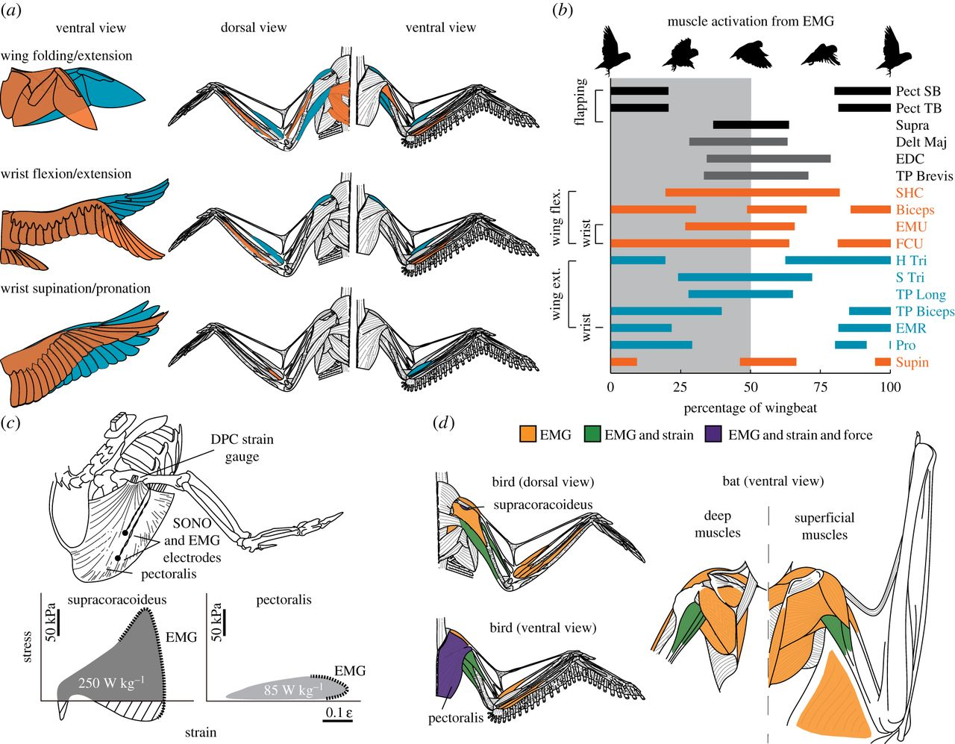
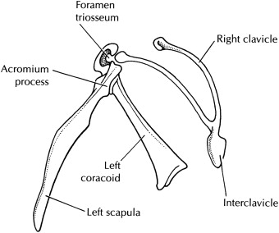

Slide 6
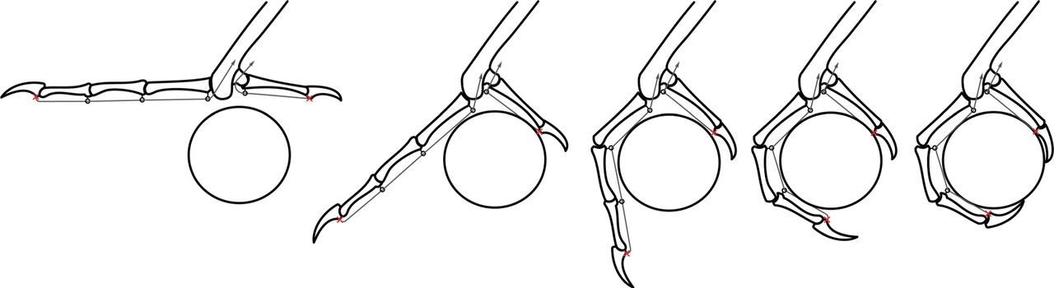
Avian osteology
Notes:
Structure of tendons in foot causes toes to flex and wrap upon contact. Thus birds can sleep while perched.

Slide 7
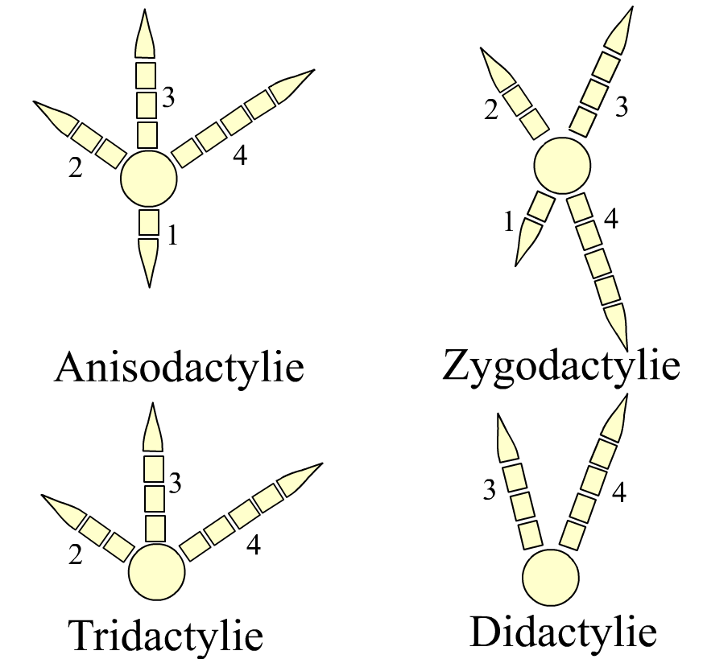
Notes:
Orientation caused by differential movement of embryo IN THE EGG, not by normal genetic means!

Slide 8
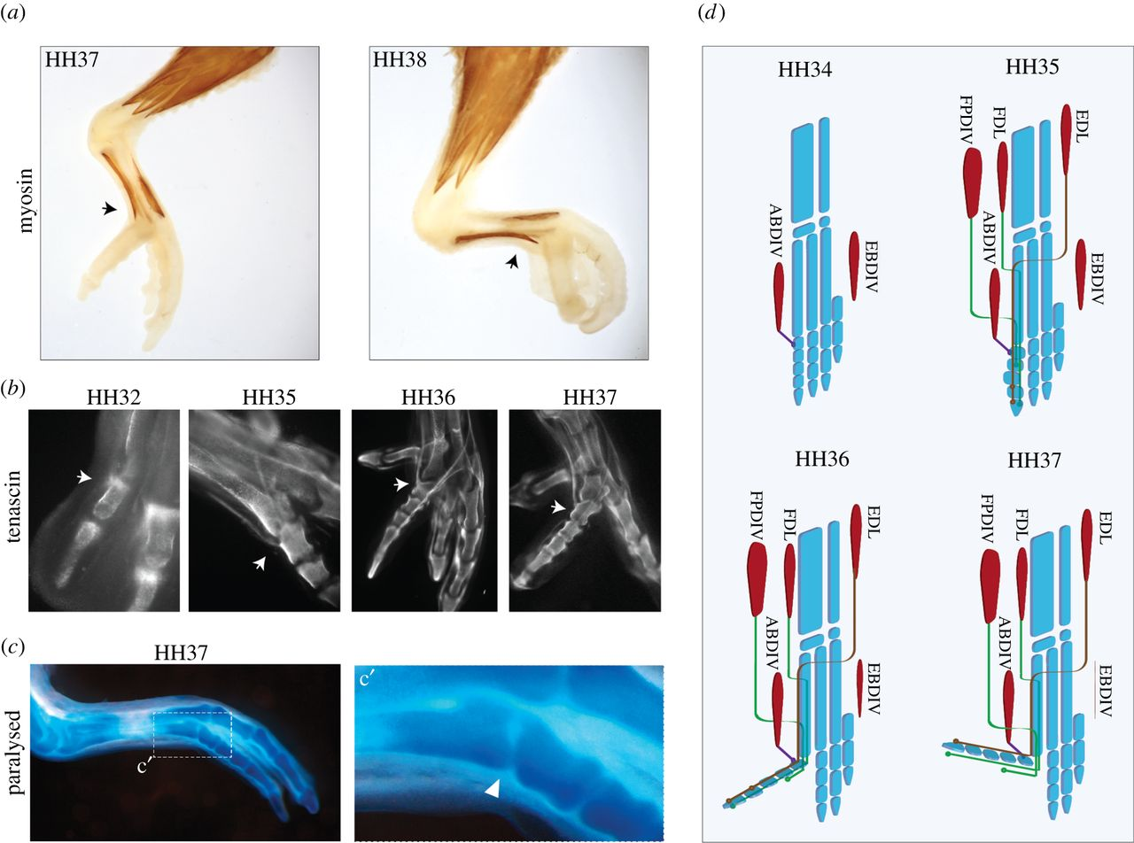
Notes:
Orientation caused by differential movement of embryo IN THE EGG, not by normal genetic means!

Slide 9
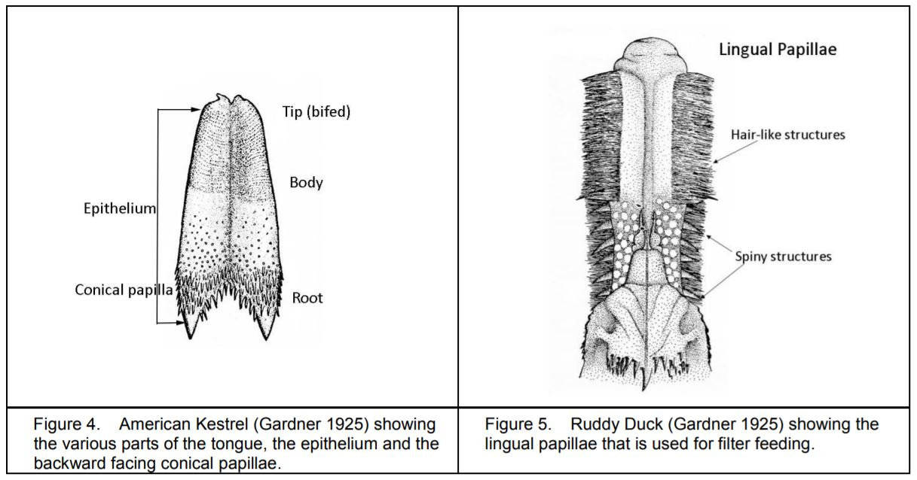
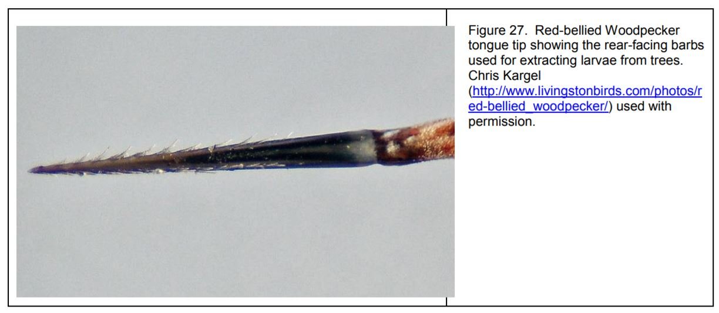
Avian tongue
Notes:
3:10
https://www.pbs.org/video/nature-secret-hummingbirds-tongue/

Slide 10
Avian tongue (Piciformes)
Notes:
3:10
https://www.pbs.org/video/nature-secret-hummingbirds-tongue/

Slide 11
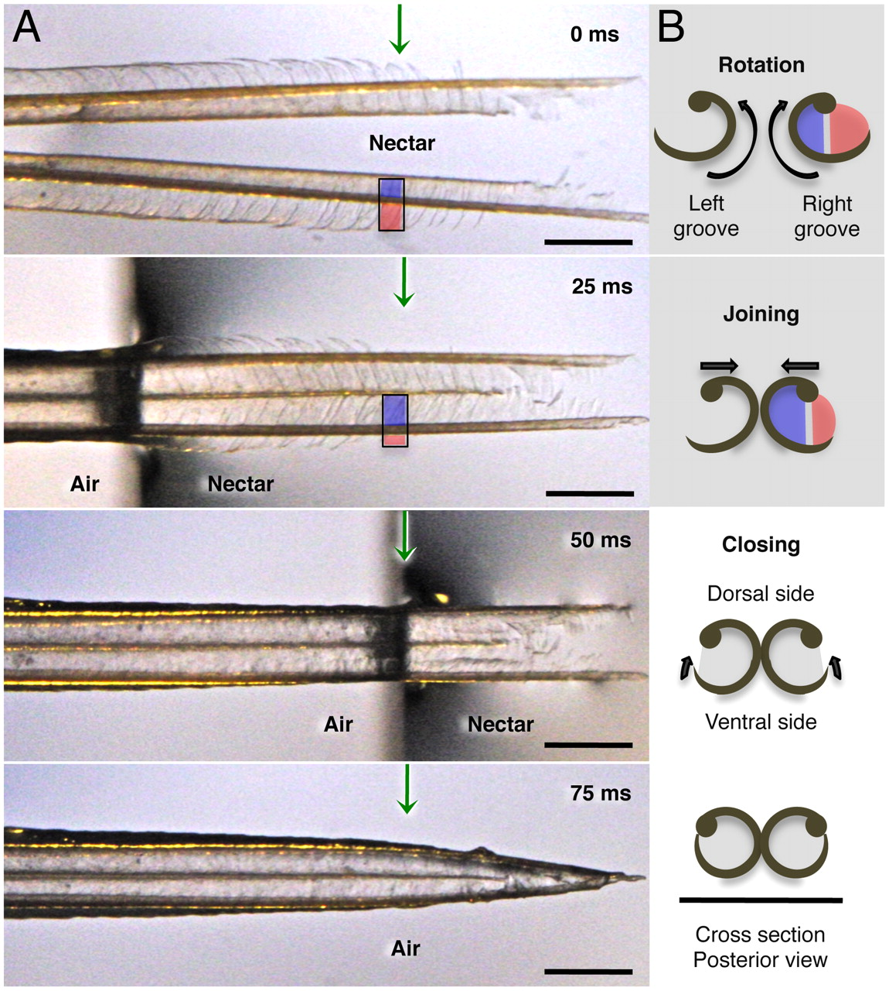
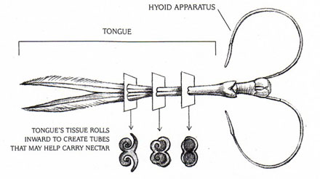
Avian tongue (Trochilidae)
Notes:
https://ww3:10
https://www.pbs.org/video/nature-secret-hummingbirds-tongue/

Slide 12
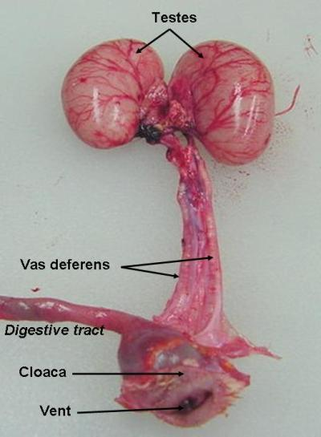
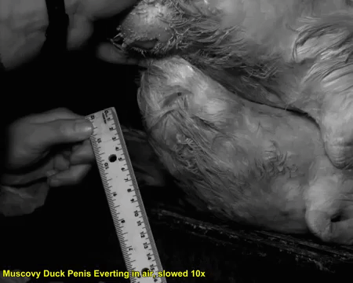
Male reproductive system

Slide 13
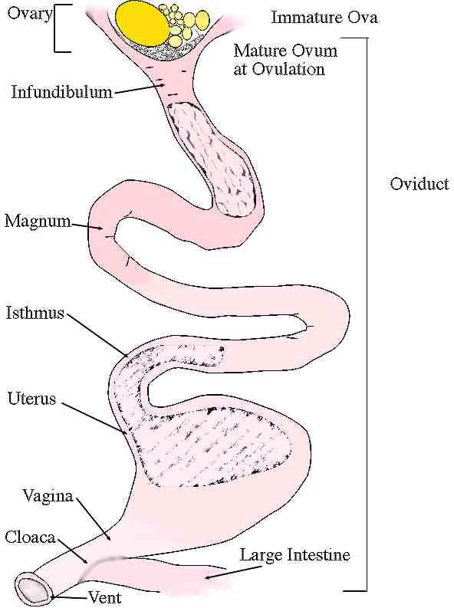
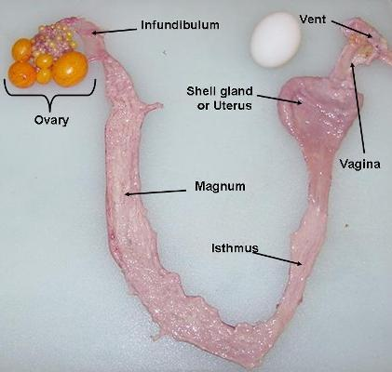
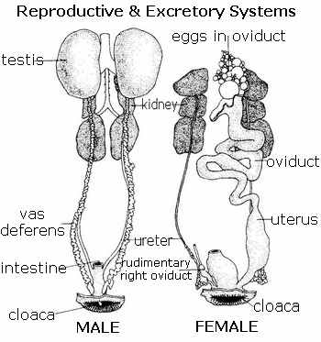
Female reproductive system

Slide 14
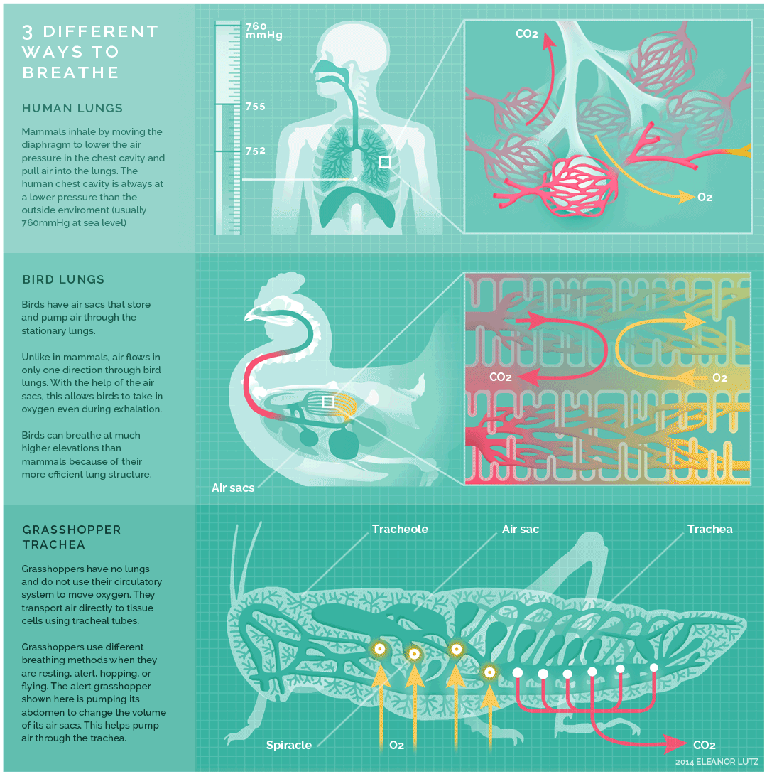
Alveolar lungs (Synapsids)
Faveolar lungs (Diapsids)

Slide 15
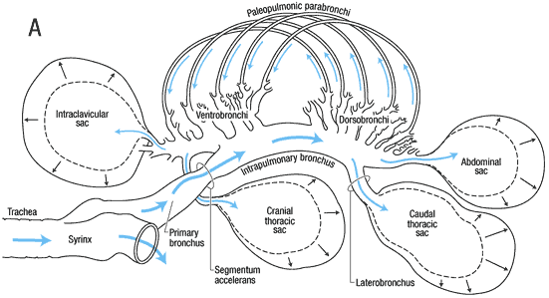
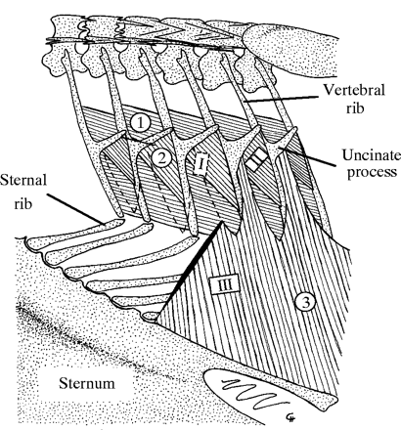
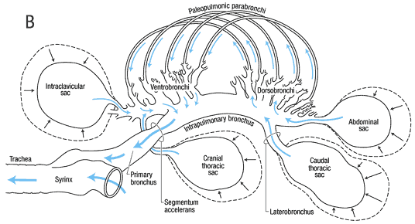
Avian respiration

Slide 16
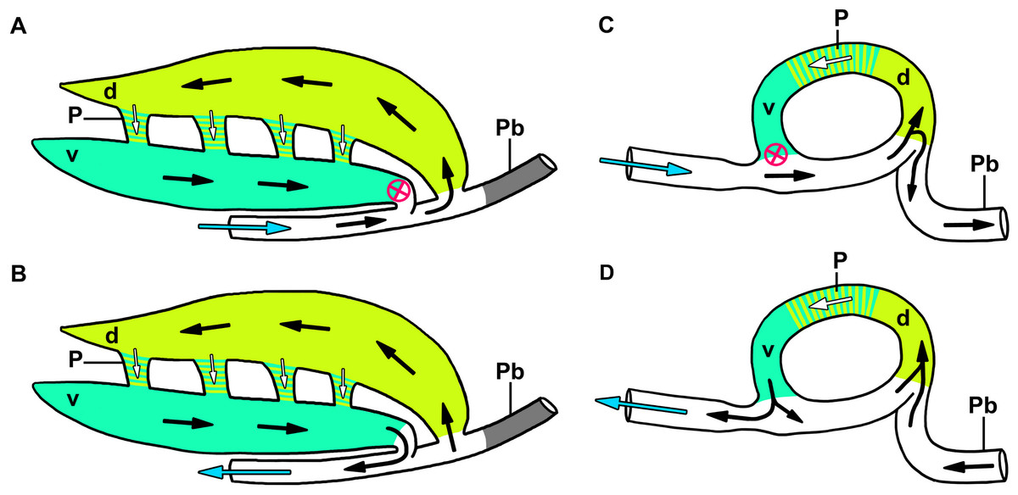
Notes:
Diagrammatic and highly simplified representation of airflow through the dorsobronchi and ventrobronchi during inspiration (A) and expiration (B) in the crocodilian lung, and inspiration (A) and expiration (D) in the avian lung. The avian model is a modification of the Hazelhoff loop (Hazelhoff, 1951). Arrows denote direction of airflow, white arrows show air flowing through the parabronchi, blue arrows show air entering the trachea, the red circled “X” demonstrates the location of the aerodynamic inspiratory valve (i.e., air does not flow through this location during inspiration). Colors represent hypothesized homologous regions of the lung in both groups. Abbreviations: d, dorsobronchi; P, parabronchi; Pb, primary bronchus; v, ventrobronchi.

Slide 17
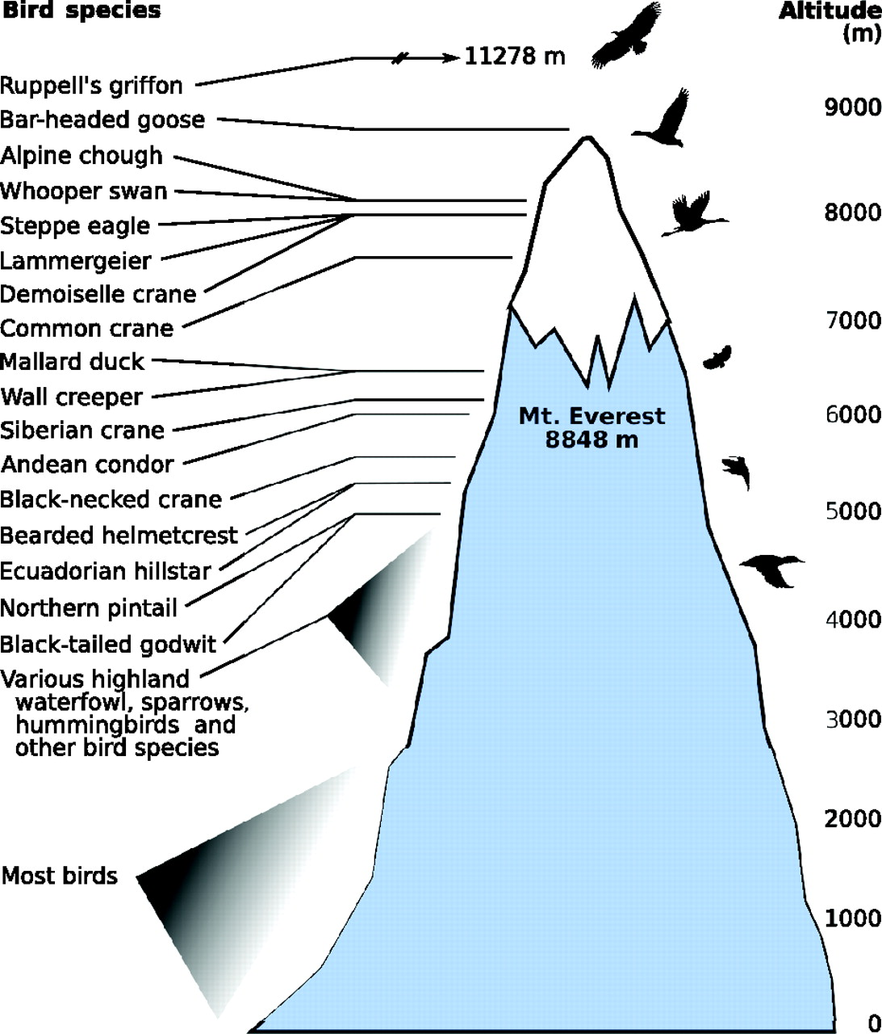

Slide 18
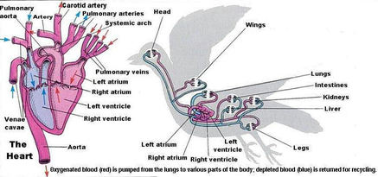
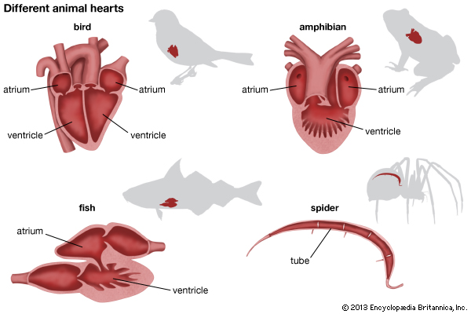
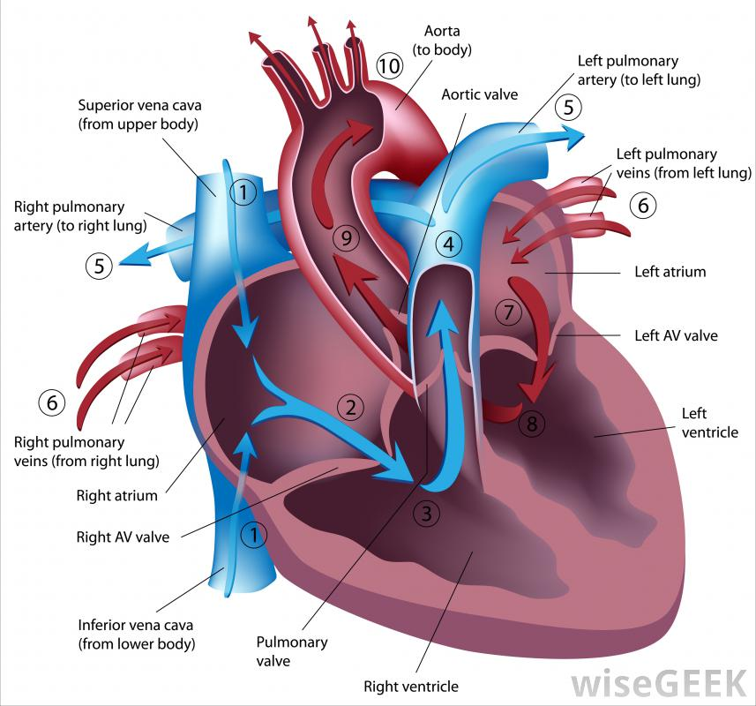
Avian circulation

Slide 19
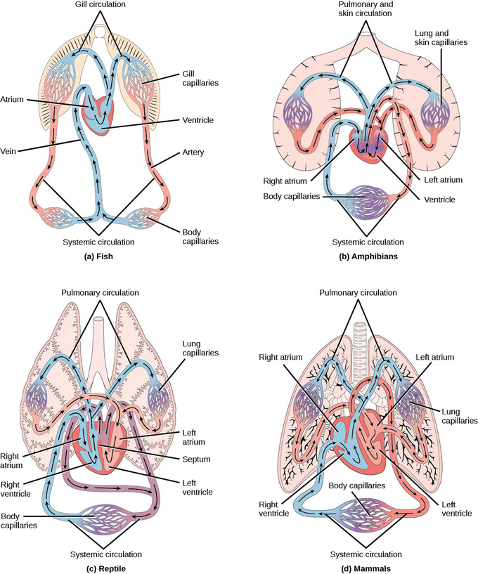

Slide 20
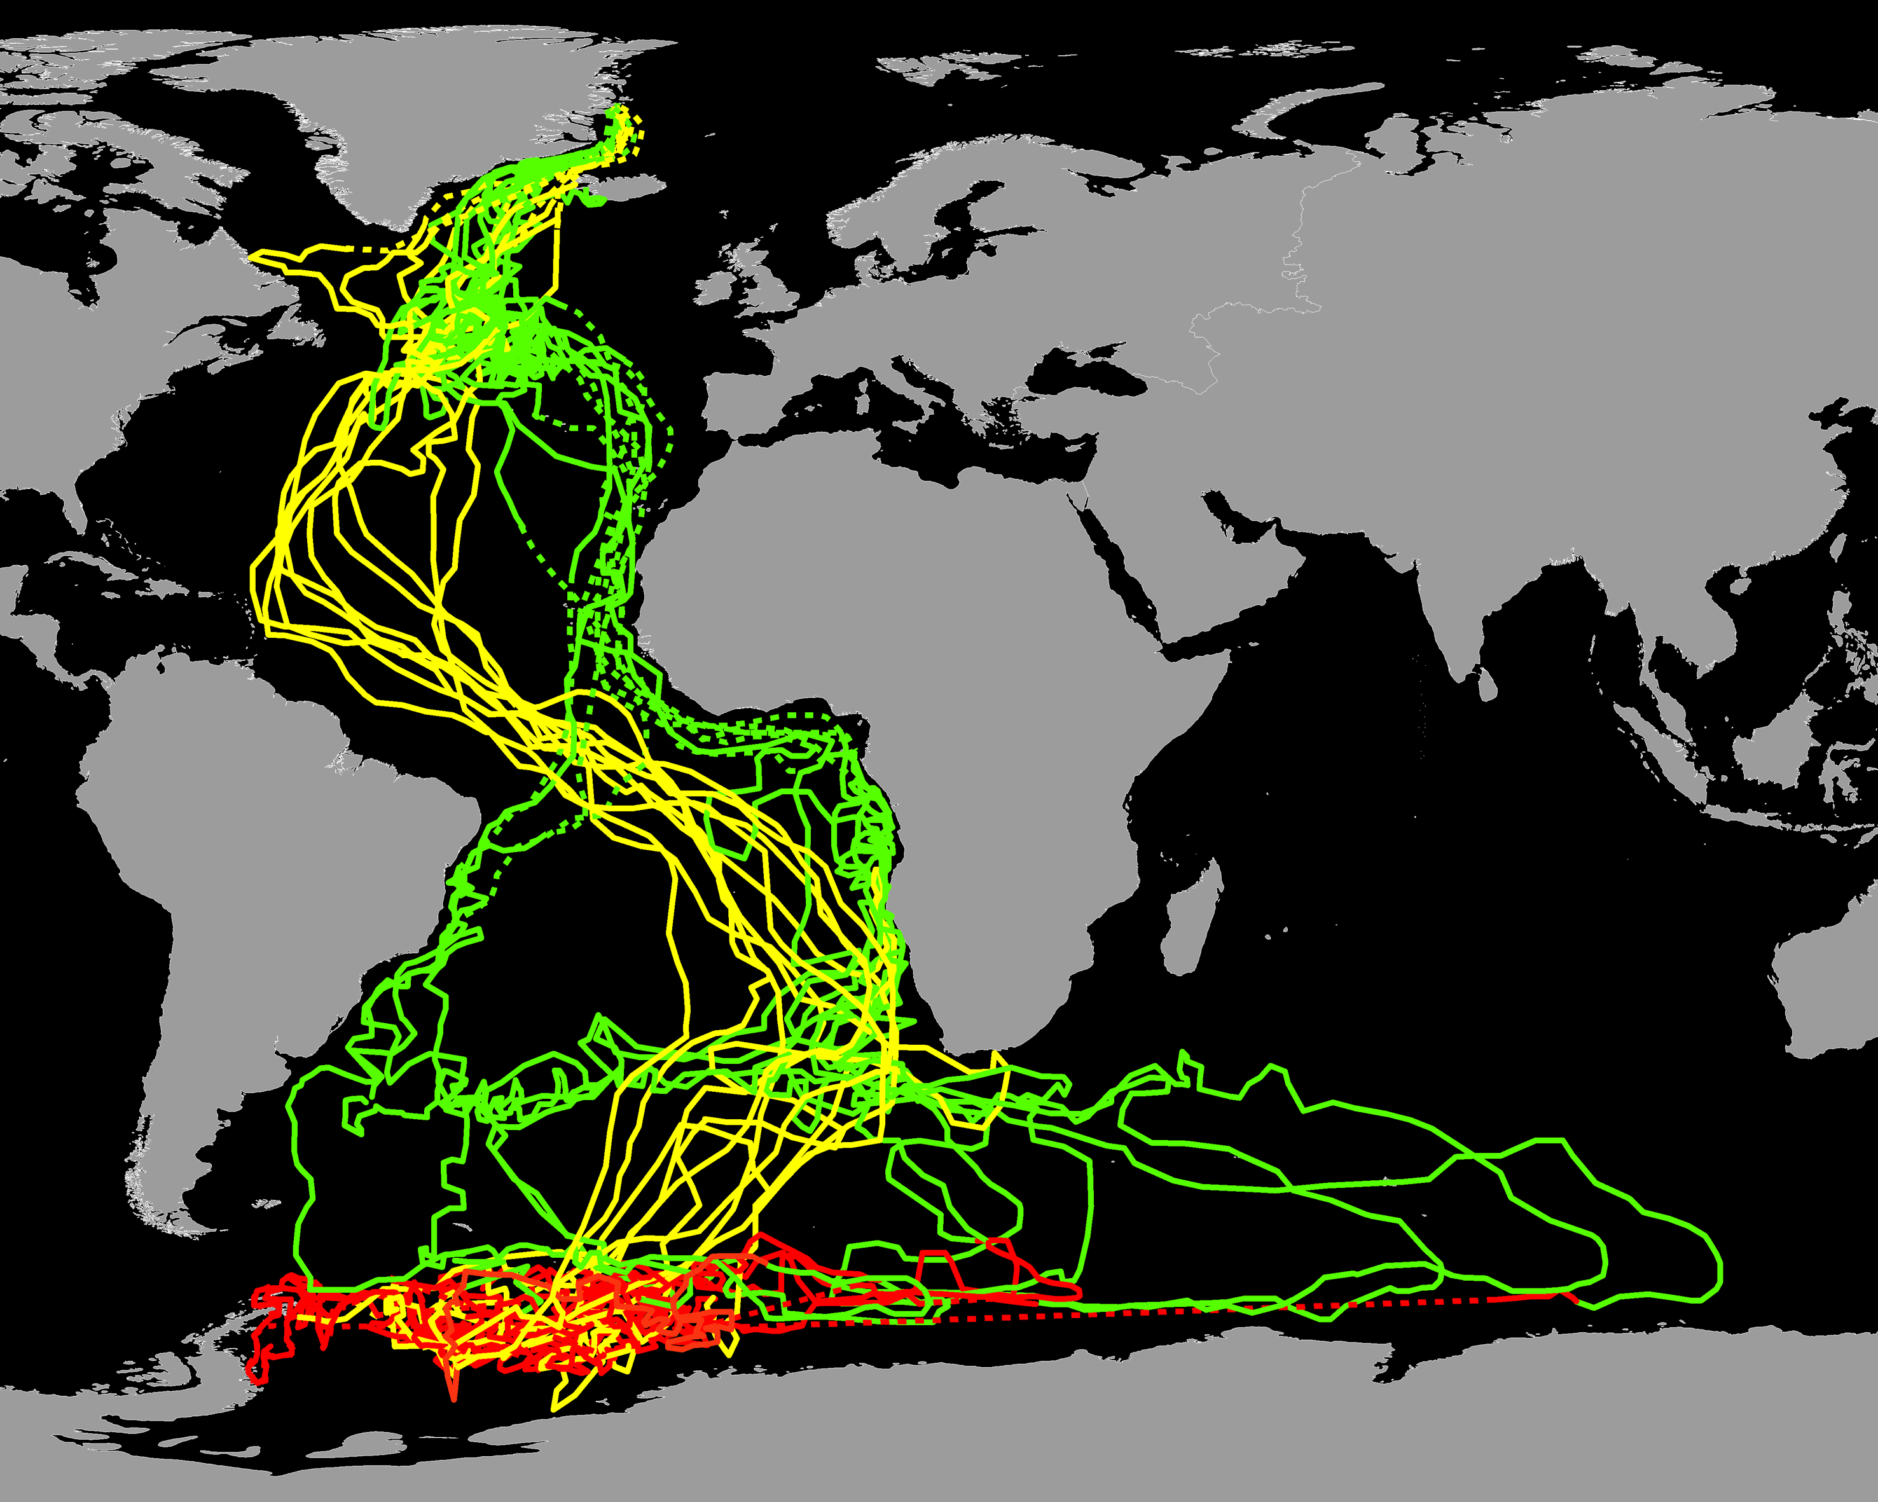
Migration

Slide 21
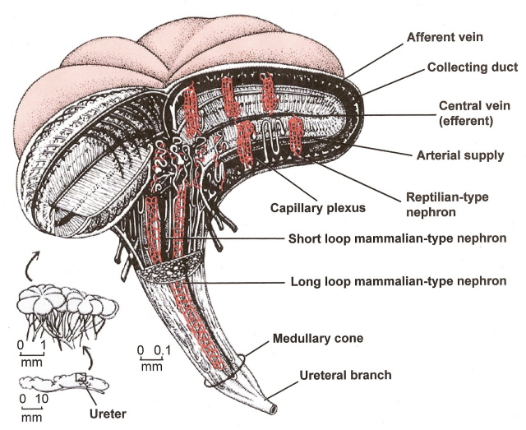
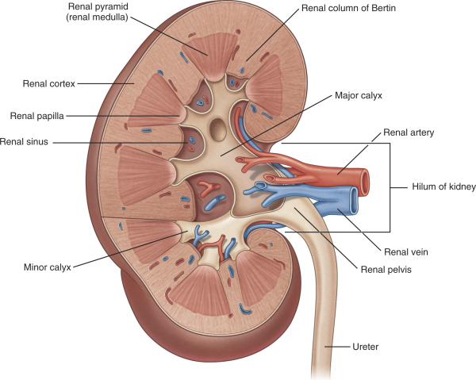
Kidneys

Slide 22
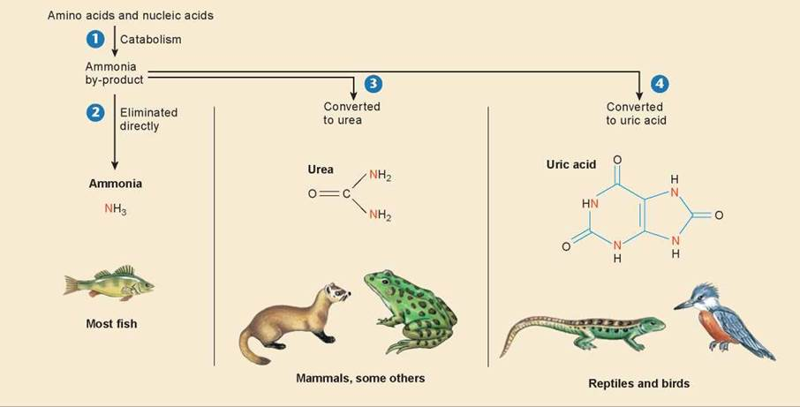

Slide 23
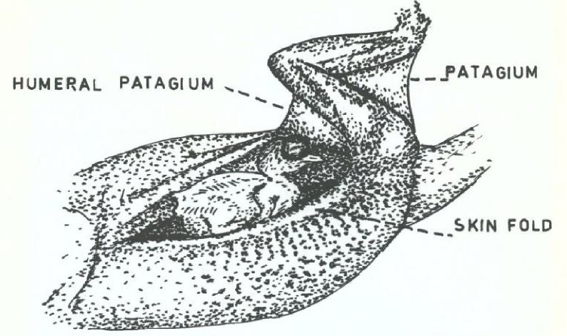
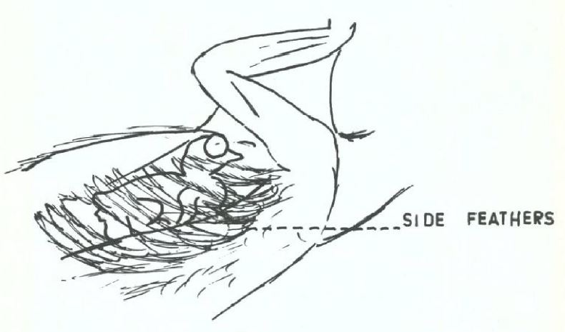
Avian pouches
Notes:
Saw pouches for young in seahorses, pipid frogs, marsupial frogs, marsupials, monotremes, and now sungrebes.

Slide 24
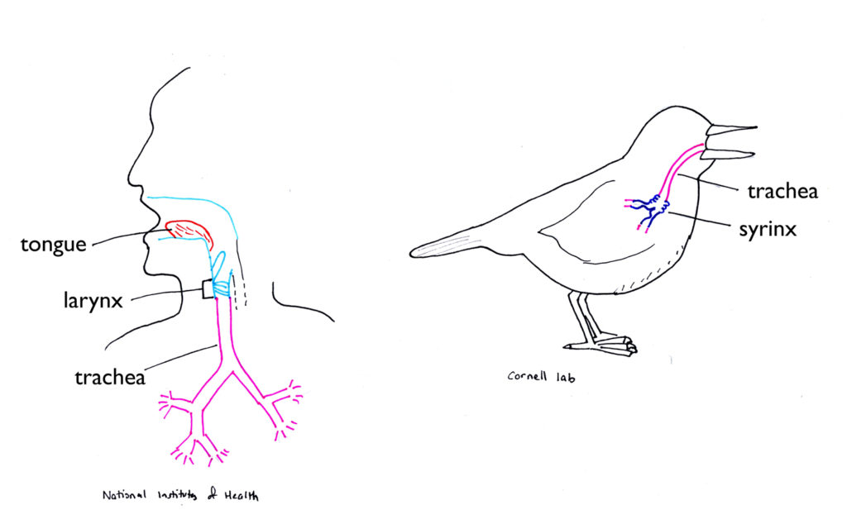

Slide 25
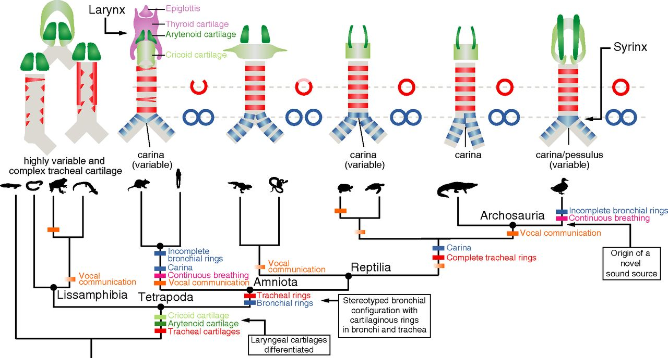

Slide 26
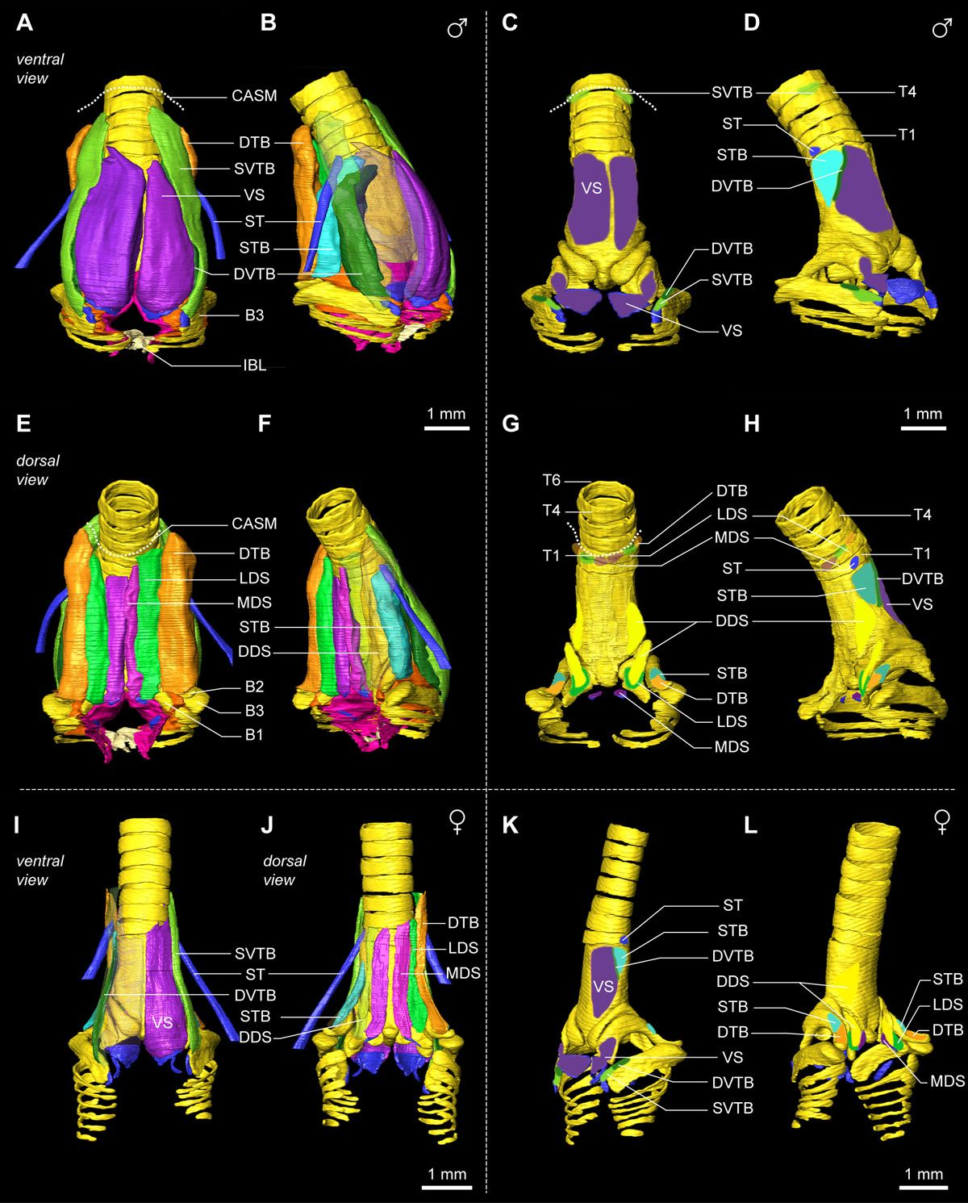
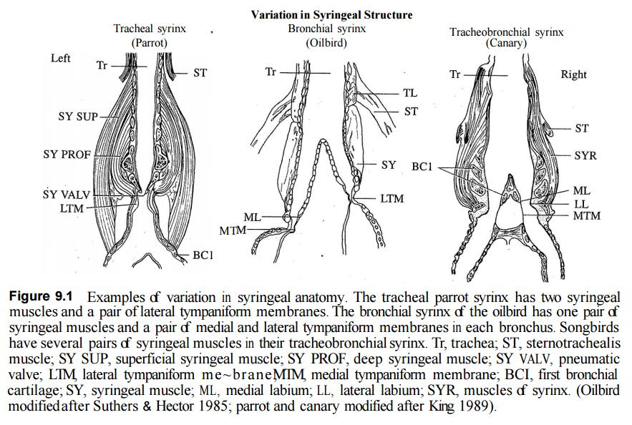

Slide 27
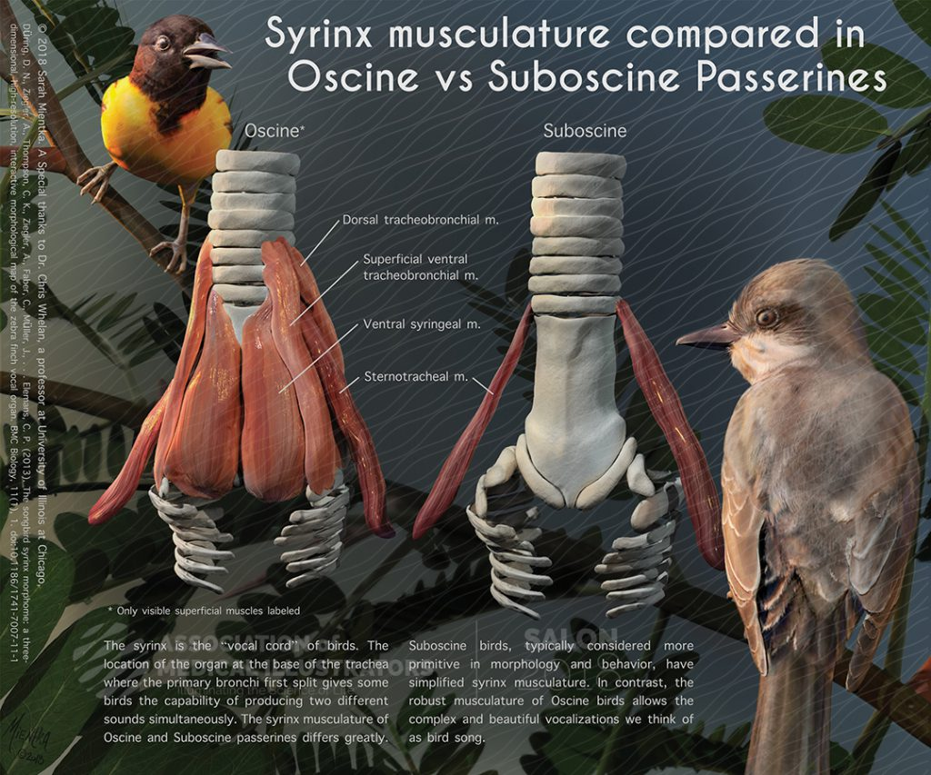

Slide 28
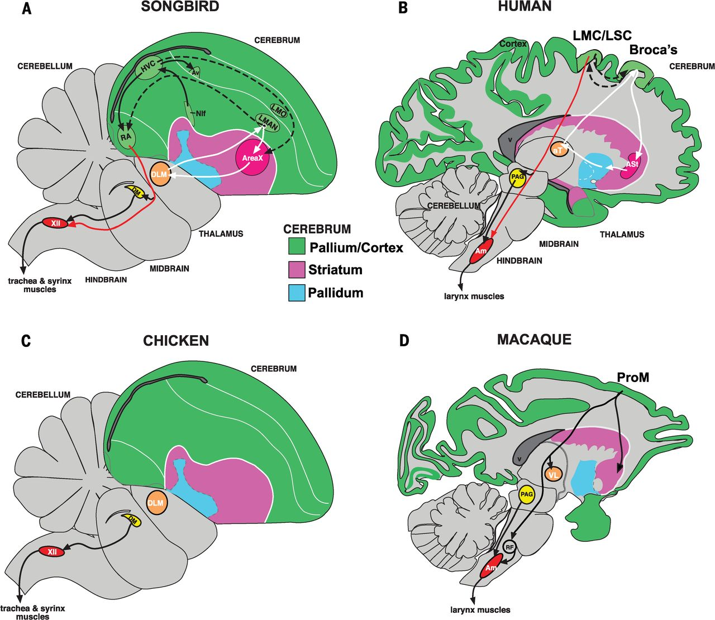

Slide 29
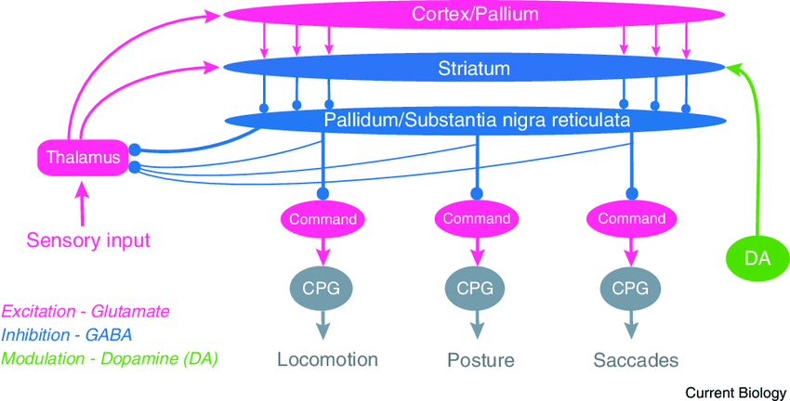
Notes:
Neurons from the pallial VZ of developing birds and reptiles (and from the pallial SVZ of birds) are added to the pallium in an outside-in pattern as the pallium expands away from the lateral ventricle, with oldest neurons situated farthest away from the ventricle. In mammals, neurons are added instead in an inside-out pattern, with the oldest neurons situated closest to the ventricle. These findings lead to the view that the similar connectivity and gene expression patterns found in adult avian and mammalian pallium may be the result of convergent evolution instead of features inherited from a common stem amniote ancestor

Slide 30
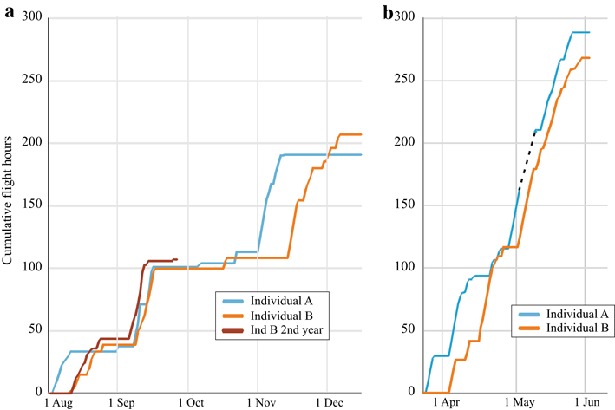
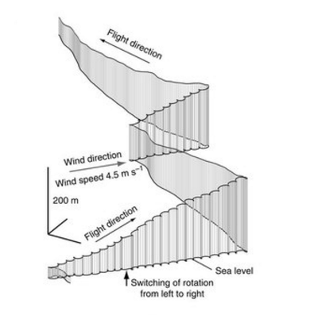
Avian brain

